Slide 1
CHAPTER 10
TELECOM POLICY
AND
BUSINESS CONTRACTS

Slide 2
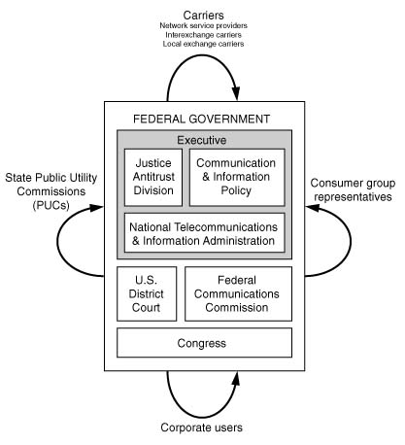
U.S. Telecom Policy Structure

Slide 3
Key Regulatory Events
Communications Act of 1934
Public Utility Commissions (PUCs) in 1935
Communications Act of 1962
Telecommunications Act of 1996
  General trends toward continuing deregulation and encouraging competition
  Business mergers and acquisitions on the rise
  Global competition continues to pose new challenges

Slide 4
Communications Act of 1934
This act established the Federal Communications Commission (FCC) to regulate interstate, international and maritime communications, with universal service stated as the goal

Slide 5
Public Utility Commissions (PUCs)
1935: Public Utility Commissions (PUCs) formed to assume intrastate regulatory authority from municipal and city governments

Slide 6
Communications Act of 1962
This act places authority with FCC to assign commercial satellite frequencies. This Act established the Communications Satellite Corporation (Comstat) to act as a carrier’s carrier (wholesaler) for international satellite service and in conjunction with Intelsat (International Telecommunications Satellite Organization)

Slide 7
Telecommunications Act of 1996
This Act was enacted by the 104th Congress of the U.S. and signed into law by President Clinton.
While the Act covers a wide range of policies, the biggest changes are in the areas of two-way voice, data, and video services

Slide 8
Goals of the Telecom Act of 1996
Telecom Act has three primary objectives:
To ensure both a timely deployment of advanced services and an underlying infrastructure necessary to support this deployment
To promote competition
  Competition among LECs
  Competition among phone and cable companies
To ensure universal service, that is, the widespread availability of basic and advanced services to consumers in all parts of the U.S.

Slide 9
Infrastructure for
Timely Deployment of
Advanced Services
Reciprocal Compensation
  Fees paid to local phone companies for use of their networks to complete the calls
Unbundled Network Elements (UNEs)
  Include seven elements that must be made available to the competitors at any technically feasible point

Slide 10
Promotion of Competition
Opening the local exchange to competition
  Local Number Portability, initiated by the FCC, allows users to change their service providers while retaining the same phone numbers
Removing legal barriers to telephone companies entering the cable business, and vice versa

Slide 11
Universal Availability of Advanced Services
Advanced (also called enhanced) telecom services are defined as high-speed, switched, or broadband telecom capabilities. Examples include: voicemail, e-mail, and various Internet-based services
The 1996 Act expresses strong concern that these services be available in all regions of the U.S.

Slide 12
Regulation on Electronic Documents
The Fair Information Act of 1974 is based on five principles (3 of 5 given here):
  There must be no personal data record-keeping systems whose very existence is secret
  There must be a way for people to find out what information about themselves is in a record and how it is used
  There must be a way for people to prevent information about themselves that was obtained for one purpose from being used or made available for other purposes without their consent

Slide 13
Regulation on Electronic Documents continued…
The Fair Information Act of 1974 is based on five principles (the remaining 2 of 5):
  There must be a way for people to correct or amend a record of identifiable information about themselves.
  Any organization creating, maintaining, using, or disseminating records of identifiable personal data must assure the reliability of the data for their intended use and must take precautions to prevent misuses of the data.

Slide 14
Intellectual Property
Intellectual property is a discipline that deals with issues in copyright, trademark, and patent law
  Copyright ensures authors the right to protect their work and to benefit from new inventions by giving then exclusive rights to such works
  Trademarks are awarded to any sign or symbol capable of distinguishing goods or services
  Patents are awarded for inventions or non-obvious improvements to existing products or processes

Slide 15
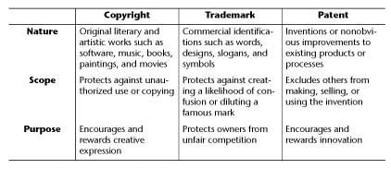
Intellectual Property Protection

Slide 16
Telecom Policy Impact on Businesses
Global Market Competitiveness
  Certification process in foreign countries varies from one country to another (may be automatic approval based on pre-approval by FCC, or may be made complicated to exclude foreign competition)
  European Union has streamlined the certification process so vendors certify the product only once for market in any EU member

Slide 17
Electronic Commerce
Electronic commerce (e-commerce) is any purchasing or selling through an electronic communications medium
Integrates three key elements:
  Communications
  Data management
  Security capabilities

Slide 18
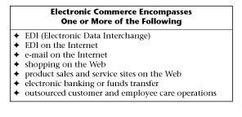
Major Components of Electronic Commerce

Slide 19
Service Level Agreement (SLA)
An SLA represents a contract between a network service provider and a customer that specifies, usually in measurable terms, certain levels of network and application performance such as throughput, delay and availability, and a promise of rebates if those parameters are not met by the provider in return for Minimum Annual Commitment (MAC) from the customer

Slide 20
Minimum Annual Commitment (MAC)
MAC is the amount of money a user organization agrees to pay a carrier each year of a multiyear contract in exchange for negotiated discounts

Slide 21
Need for a SLA
Dramatic increase in “network outsourcing” has created a need to ensure optimal performance of the enterprise network and mission-critical applications
Network downtime translates to “dollars lost”
SLA guarantees a specific QoS for the client
SLA is valuable to the service provider as well, to avoid any unrealistic expectations from the client

Slide 22
Selecting a Service Provider
Selecting a service-provider is a business-critical decision
Process of analyzing carriers’ various offerings with the organization’s unique needs and finding a perfect or near-perfect match
Main issues to evaluate:
  Accessibility, Latency, Response time, Security, and Support for new applications
Not only is the network being outsourced, but the recent trend is to outsource data storage as well

Slide 23
SLA Clauses
Basic elements of every SLA:
  Parties to the Agreement
  Terms of the Agreement
  Services Included
  Nonperformance
  Optional Services
  Monitoring and Reporting
  Other Provisions

Slide 24
Additional SLA Clauses
Possible elements of an SLA:
  Technology displacement clause
  Business change clause
  Competitive termination clause
  International clause
  Carry forward/Carry back clause

Slide 25
SLA Monitoring Tools
Real-time monitoring
  Used to capture data to report service-quality statistics to customers
Historical monitoring
  Used to spot trends that may lead to future problems
Both Hardware and Software Tools are Used in Conjunction to Enhance the Efficacy of Monitoring
  Hardware: WAN probe inserted between a CSU/DSU and service-provider demarcation point
  Software: CSU/DSU with SNMP capabilities

Slide 26
Total Cost of Ownership (TCO)
TCO consists of the cost of equipment, bandwidth, network, and operations
TCO involves four major components:
  Administrative activities
  Operational activities
  Technical activities
  Capital

Slide 27
Cost/Benefit Analysis
Cost is a relative term. True costs include both the long-term investments, coupled with the returns on investment
Benefits are classified into two categories:
  Hard benefits can be easily assigned objective and predictable dollar figures
  Soft benefits are more difficult to quantify and sometimes even to identify

Slide 28
Return On Investment (ROI)
ROI
  Is how much profit or cost saving is realized for a given use of money
Calculating ROI involves the following steps:
  Identify a business problem
  Quantify the business problem
  Assess technology alternatives
  Make a decision
Business Impact of a Problem = Frequency of Outage X Cost Per Outage

Slide 29
Cost of Outage
T_{o} is the Time (or length) of Outage
T_{d} is the Time (or length) of Data Loss
H_{r} is the Rate for Human Costs
P_{r} is the Rate of Profitability
Cost of Outage = (T_{o} + T_{d}) x (H_{r} + P_{r})

Slide 30
Key Terms in TCO Analysis
Life Cycle
  Length of time an organization can realistically expect to use the item in its planned role before discarding or replacing it
Net value
  Ratio of the benefits of a network divided by the costs of a network

